Slide 1
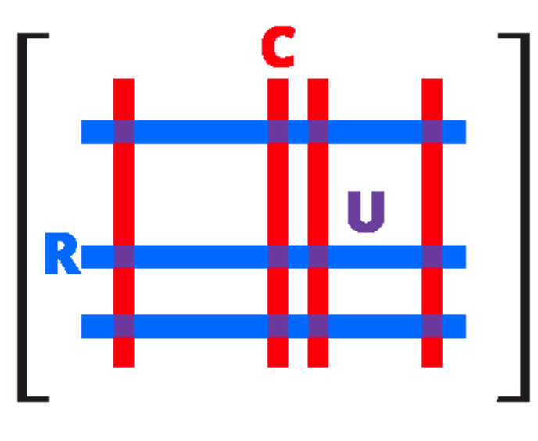
CUR Matrix Decomposition for Improved Data Analysis
Pranav Pothan (MDS202429) Raja S (MDS202430) Riya S Huddar(MDS202431)

Slide 2
Abstract
Traditional Singular Value Decomposition (SVD) is effective for data analysis but often hard to interpret, as its components involve all data points.
CUR matrix decomposition offers a more interpretable alternative by selecting a small number of actual rows and columns from the data matrix.
We propose a method that selects rows and columns based on statistical leverage, identifying the most influential parts of the data.
This approach provides better relative-error approximations and is highly useful for Exploratory Data Analysis (EDA).

Slide 3
Introduction
Modern datasets are often represented by large matrices (m × n) about m objects and n features.
Example : documents, genomes
In many cases, an important step in the analysis of such data is to construct a compressed representation of A that may be easier to analyze and interpret.
The most common such representation is obtained by truncating the SVD at some number k << min{m, n} terms (rank).
SVD of a general matrix :
There exists
Left Singular vectors :
Right Singular vectors :
Diagonal matrix with singular values
where the singular values :

Slide 4
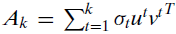
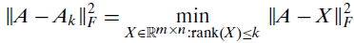
Introduction
SVD is widely used in data analysis, often via methods such as PCA, in large part because the subspaces spanned by the vectors in the truncating the SVD to some small number k of terms provide the best rank-k approximation to the data matrix A.
Choosing k such that and
the best rank k approximation
Then,
X is any rank k approximation of A that has the minimum error associated with.

Slide 5
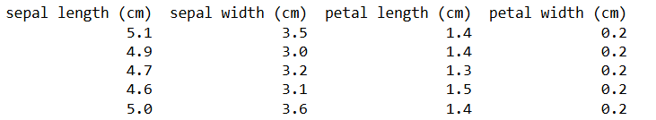
Drawbacks of SVD in Data Analysis
Example : The Iris dataset
The data is multivariate, with 150 measurements of 4 features (length and width cm of both sepal and petal) on 3 distinct Iris species.
First 5 rows of the Data,
(150 x 4)

Slide 6
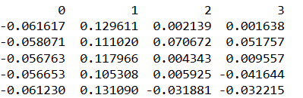
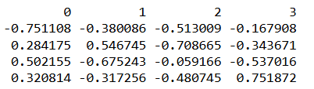
Drawbacks of SVD in Data Analysis
After performing reduced SVD,
For example, If the top 2 singular vectors of the above decomposition captures good amount of variance, the new directions are not easily interpretable because they are mathematical abstractions that can be calculated for any data matrix. They are not “things” with a “physical” reality.
This is problematic when one is interested in extracting insight from the output of data analysis algos.
And Reification cannot arise from the mathematics alone and requires an intimate knowledge of the field from which the data are drawn.
U (150 x 4)
V (4 x 4)

Slide 7
CUR Decomposition
To address this interpretability issue in Data Analysis,
CUR matrix decompositions, i.e., low-rank matrix decompositions that are explicitly expressed in terms of a small number of actual columns and/or actual rows of the original data matrix.
For an m×n matrix A, we decompose it as a product of 3 matrices, A = CUR
C - small number of actual columns of A,
R - small number of actual rows of A and
U - small carefully constructed matrix that guarantees that the product CUR is “close” to A
The extent to which A ≈ CUR, depends sensitively on the choice of C and R, as well as on the construction of U.
Thus, C and/or R can be used in place of the eigen columns and eigen rows, but since they consist of actual data elements they will be interpretable in terms of the field from which the data are drawn

Slide 8
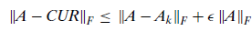
Prior Works
Frieze, Kannan, and Vempala randomly sampled columns of A according to a probability distribution that depends on the Euclidean norms of those columns.
Worst-case additive-error guarantees of the form,
Drineas, Kannan, and Mahoney have chosen the columns and rows simultaneously and constructed CUR matrix decomposition.
Worst-case additive-error guarantees of the form,
But these additive-error matrix decompositions are, however, quite coarse in the worse case.
Moreover, the insights provided by their sampling probabilities into the data are limited—the probabilities are often uniform due to data preprocessing.

Slide 9
Improved CUR Decomposition (Statistical Leverage based)
To construct C, we will compute an “importance score” for each column of A.
Small number of columns are randomly sampled from A by using that score as an importance sampling probability distribution.
Choosing columns that exert a disproportionately large influence on the best low-rank fit and such that to ensure that CUR is nearly as good as Ak at capturing the dominant part of the spectrum of A.

Slide 10
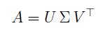
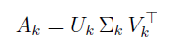
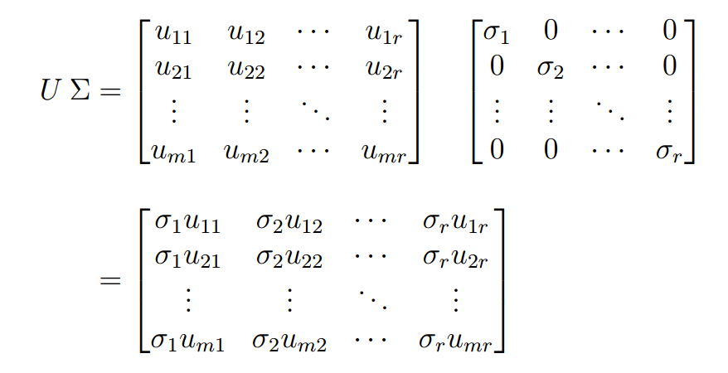
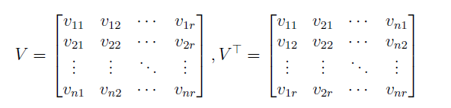
Improved CUR Decomposition (Statistical Leverage based)
Statistical Leverage Scores Computation
We know from SVD,
For low-rank K Approximation,
Computing U ∑ V^T to find out the intuition behind the computation of statistical leverage scores,

Slide 11
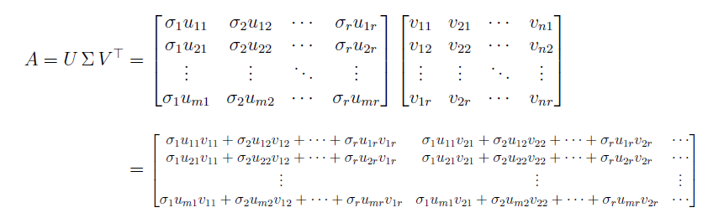
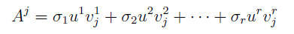
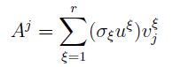
Improved CUR Decomposition (Statistical Leverage based)
Statistical Leverage Scores Computation
The columns of original matrix A can be represented as (Column View),
Thus the jth column of A is a linear combination of all the left singular vectors and singular values, and especially the elements of the jth column of V^{T} are the weights.

Slide 12
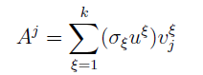
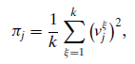
Improved CUR Decomposition (Statistical Leverage based)
Statistical Leverage Scores Computation
We can observe that every jth columns of A is weighted by the jth column of V^T,
Thus normalized statistical leverage scores can be computed from Vj’s i.e. the right singular vectors.
, for all j = 1, . . . , n
With this normalization, it is straightforward to show that
πj ≥ 0 and than j =1 πj = 1, and these scores form a probability distribution over the n columns.

Slide 13
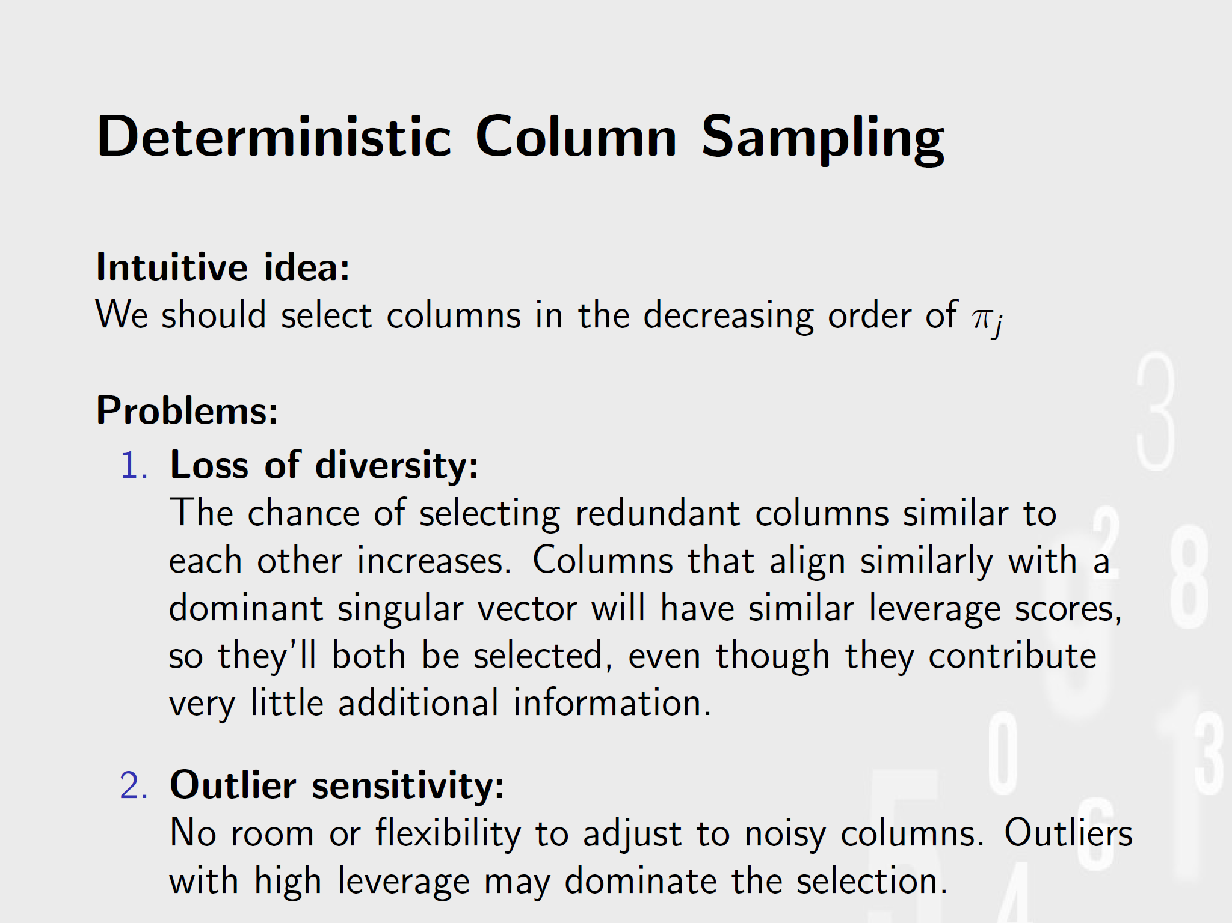

Slide 14
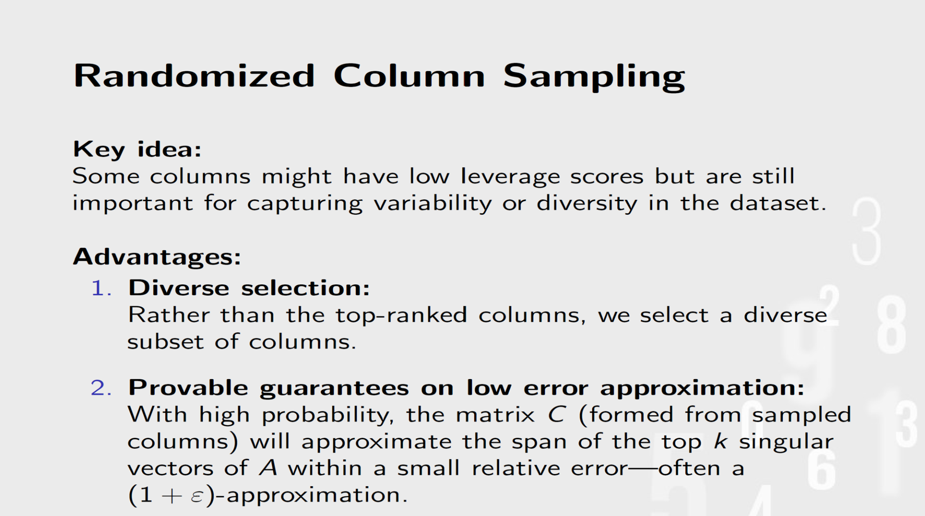

Slide 15
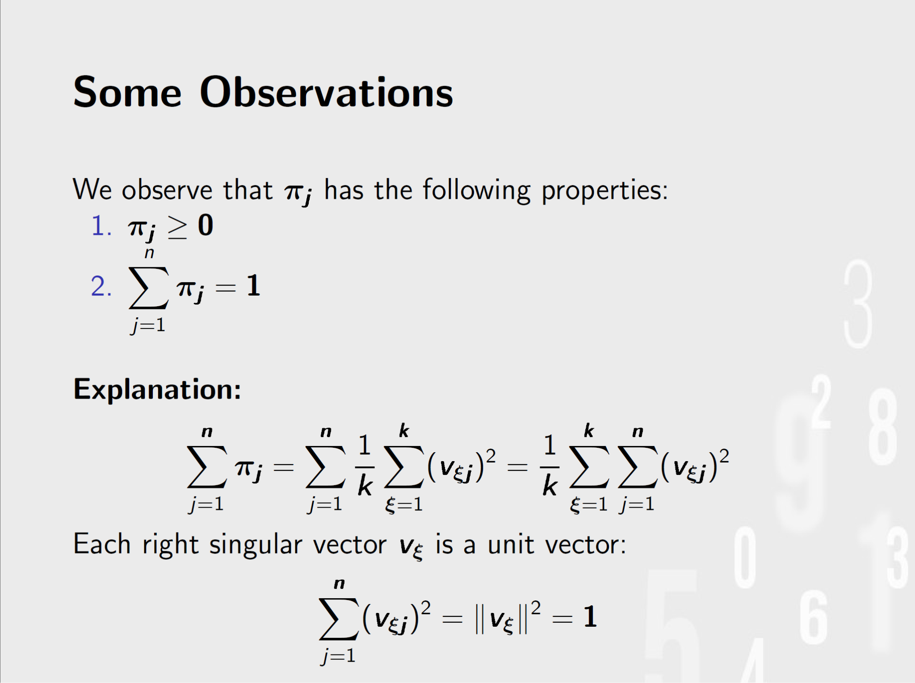

Slide 16
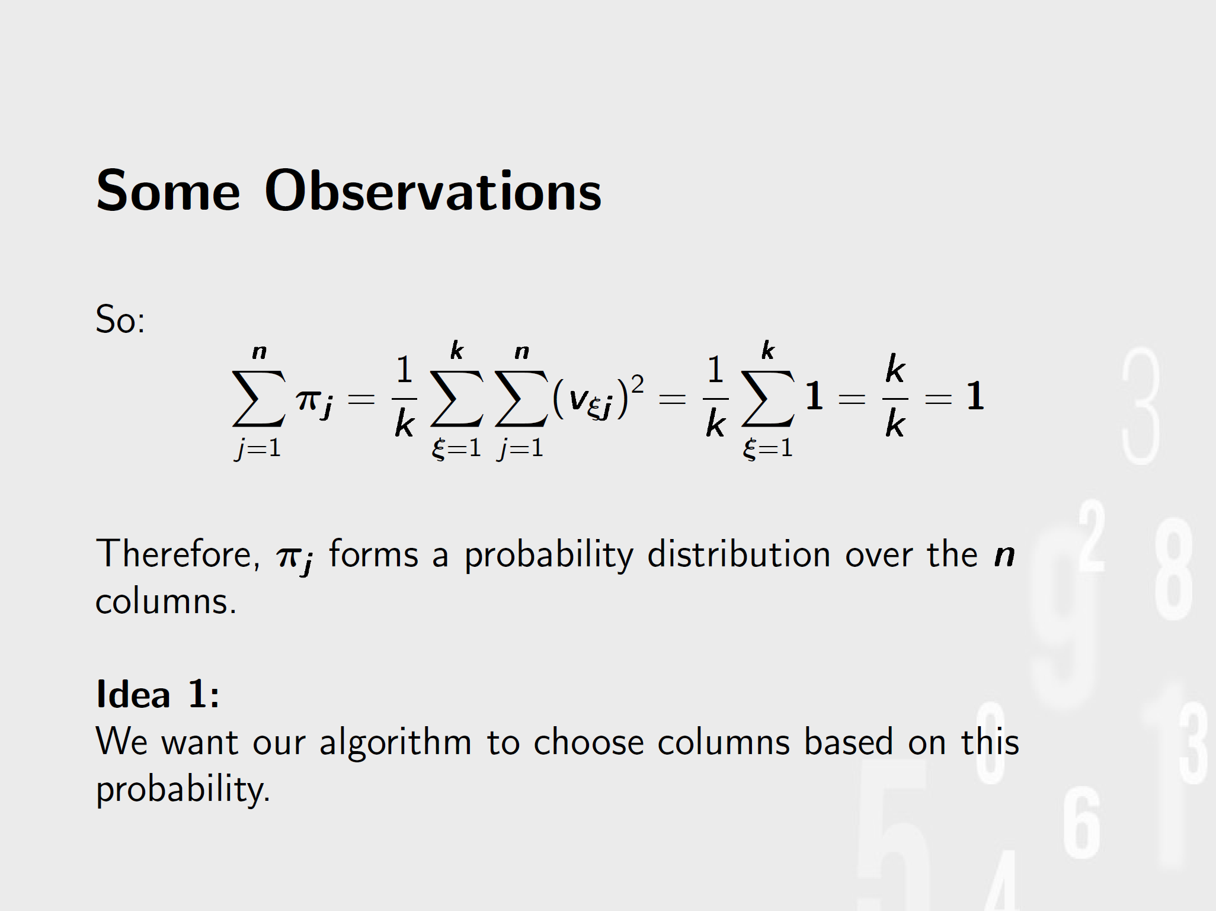

Slide 17
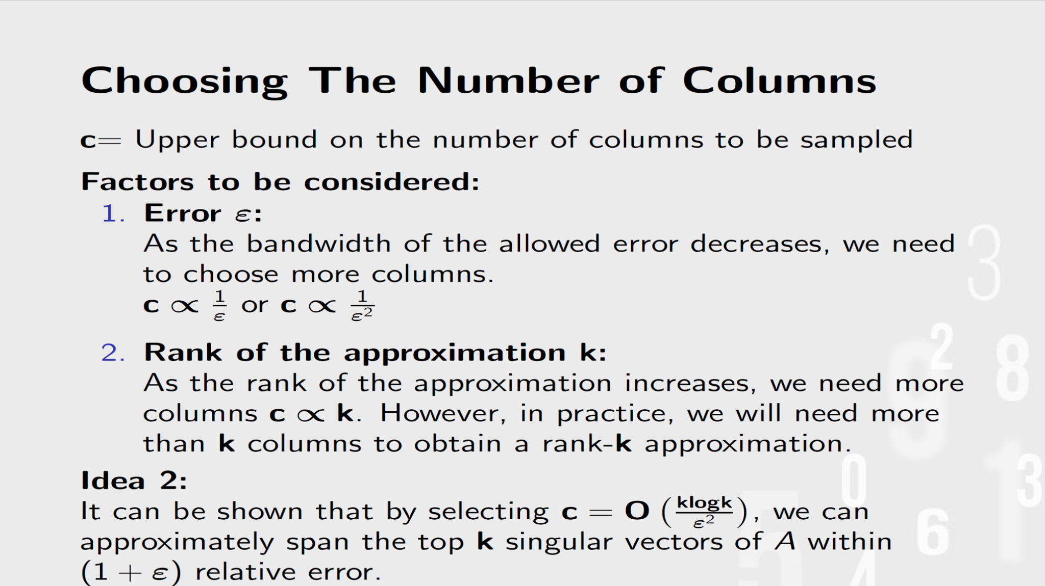

Slide 18
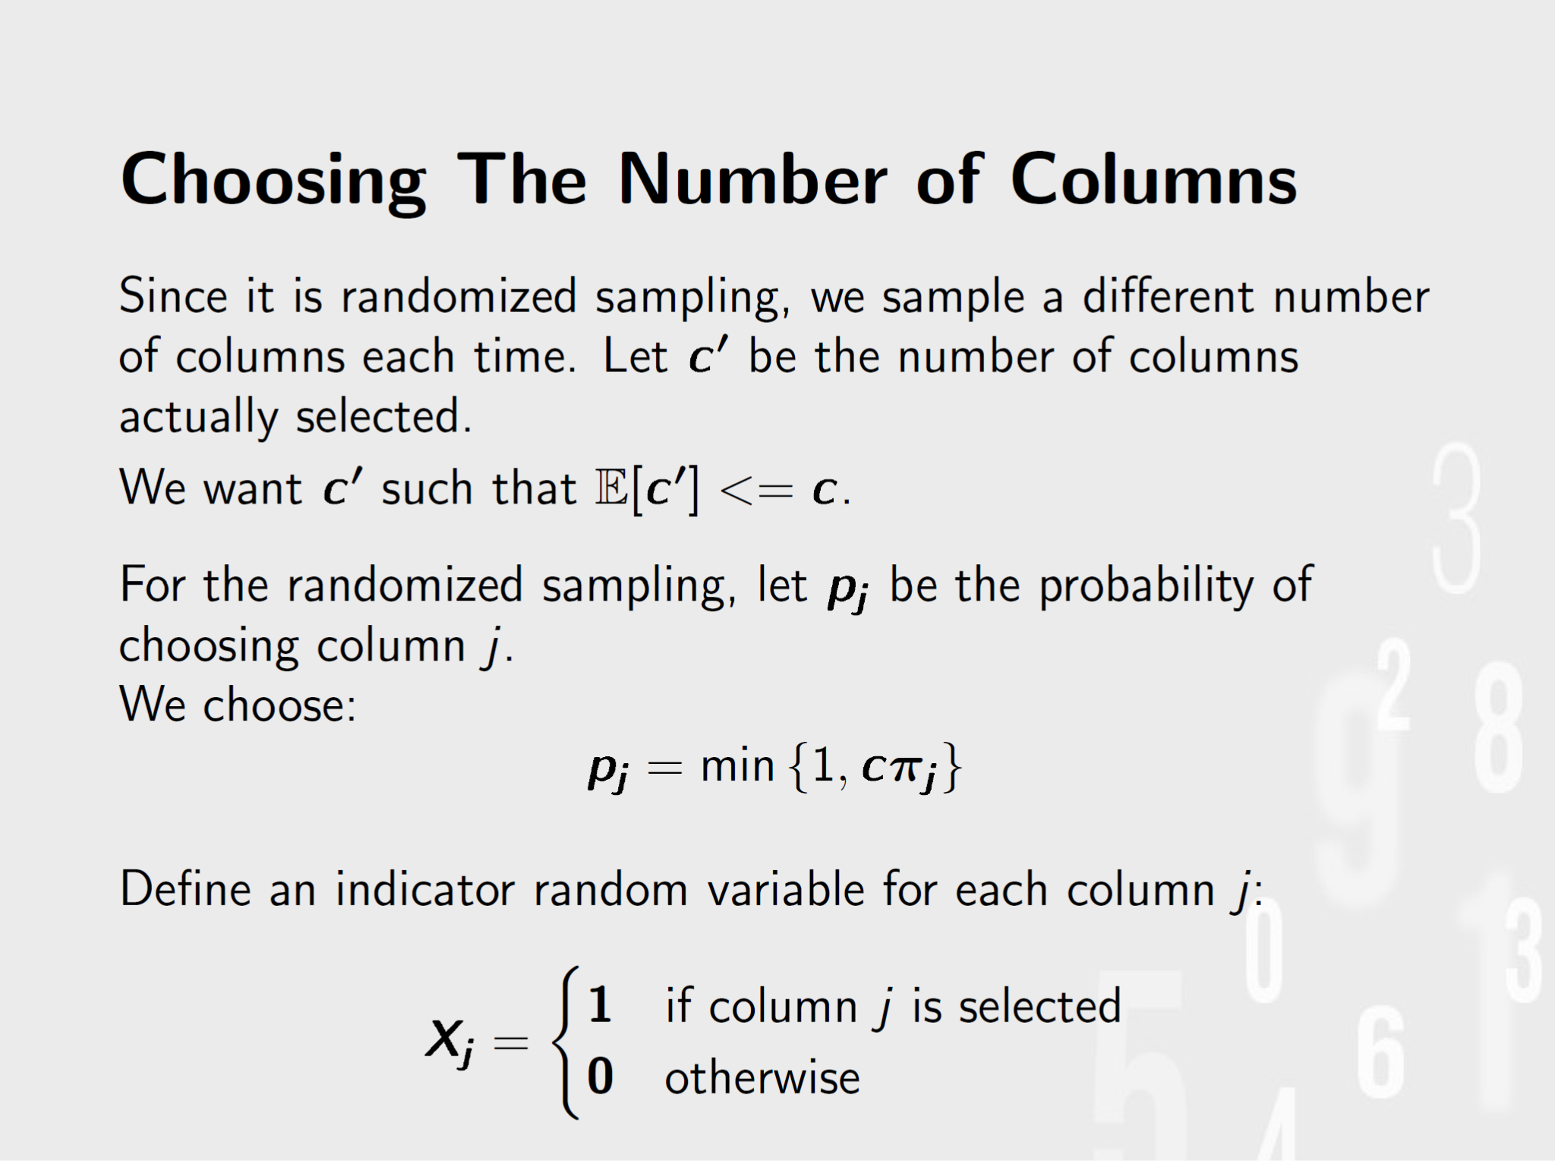

Slide 19
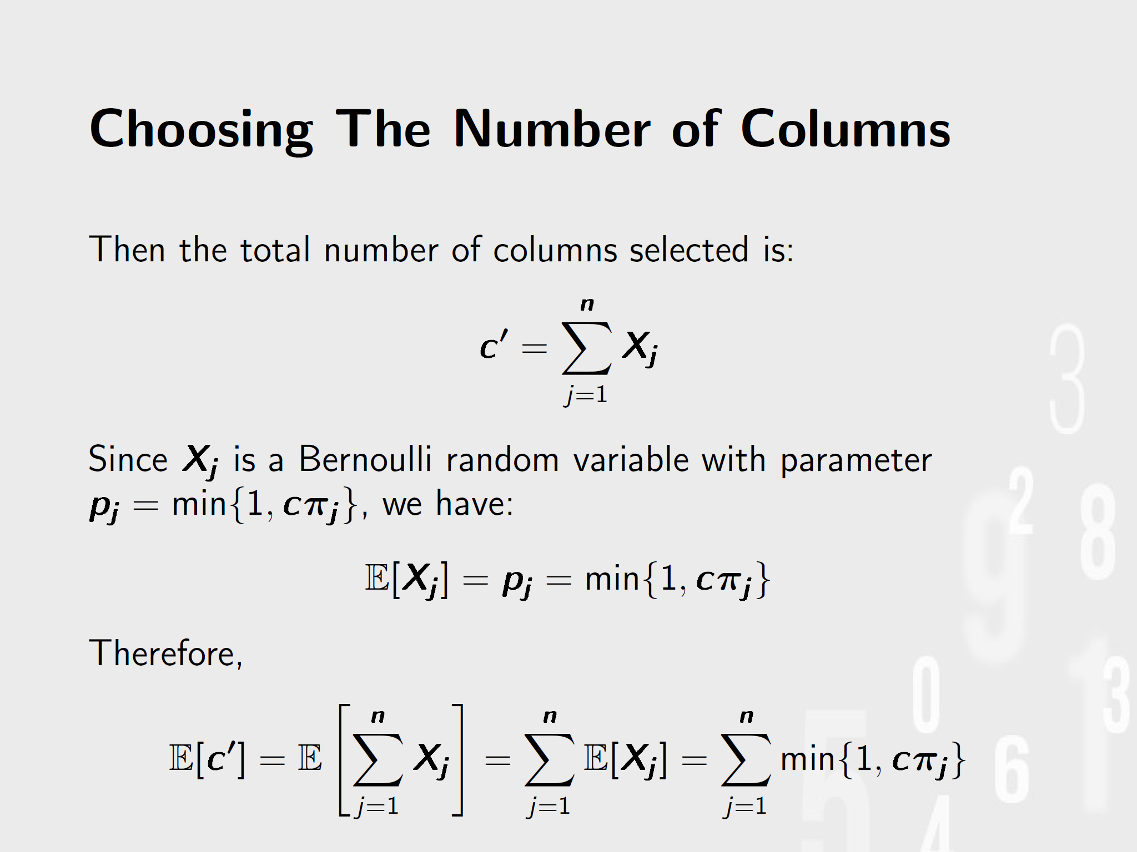

Slide 20
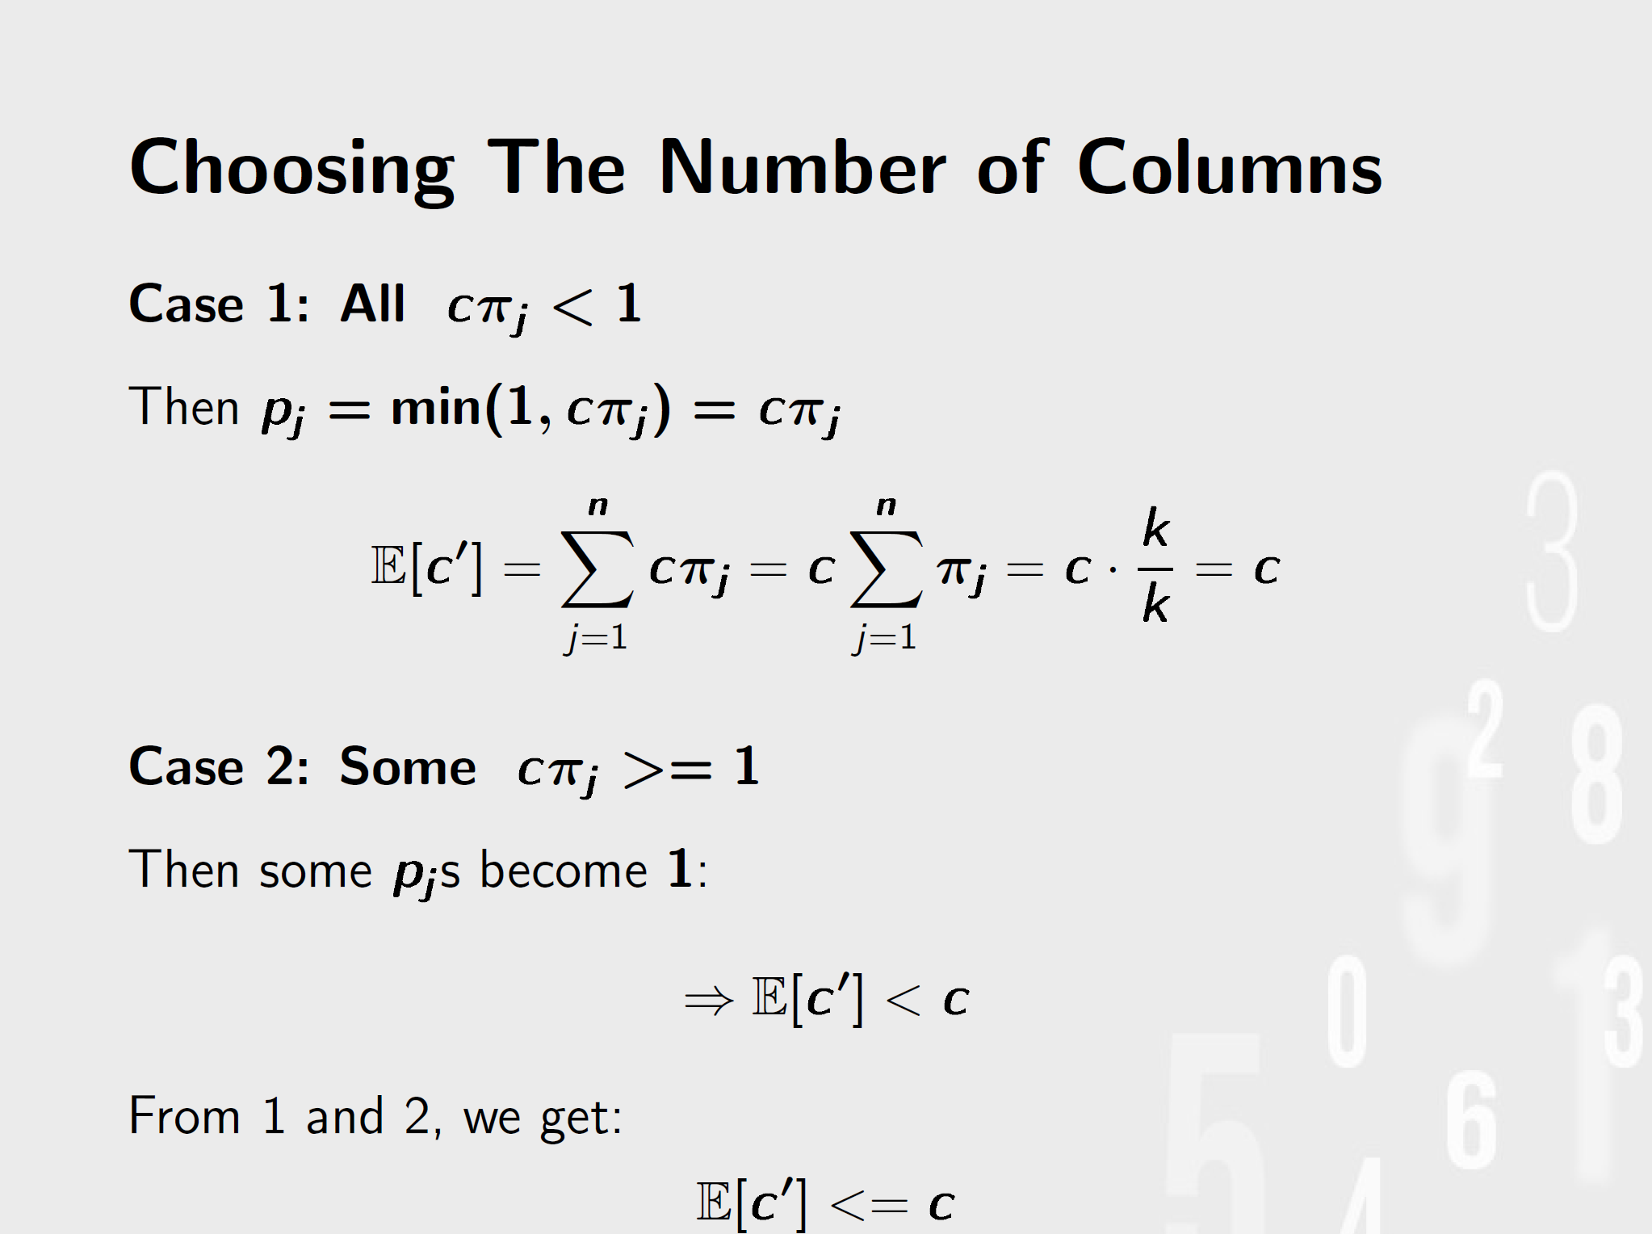

Slide 21
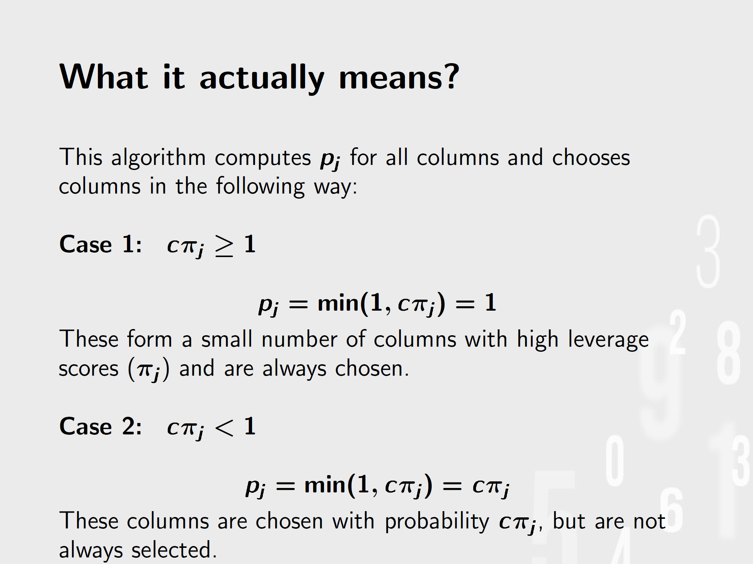

Slide 22
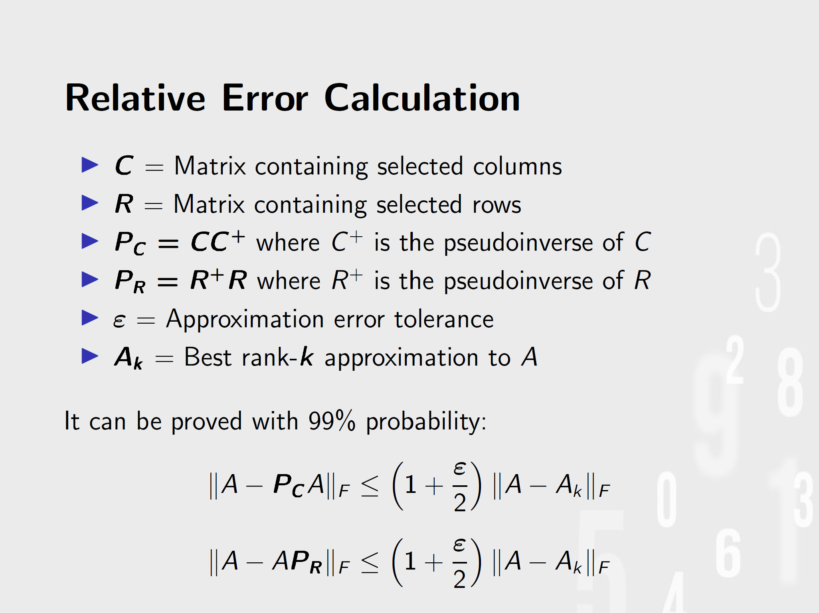

Slide 23
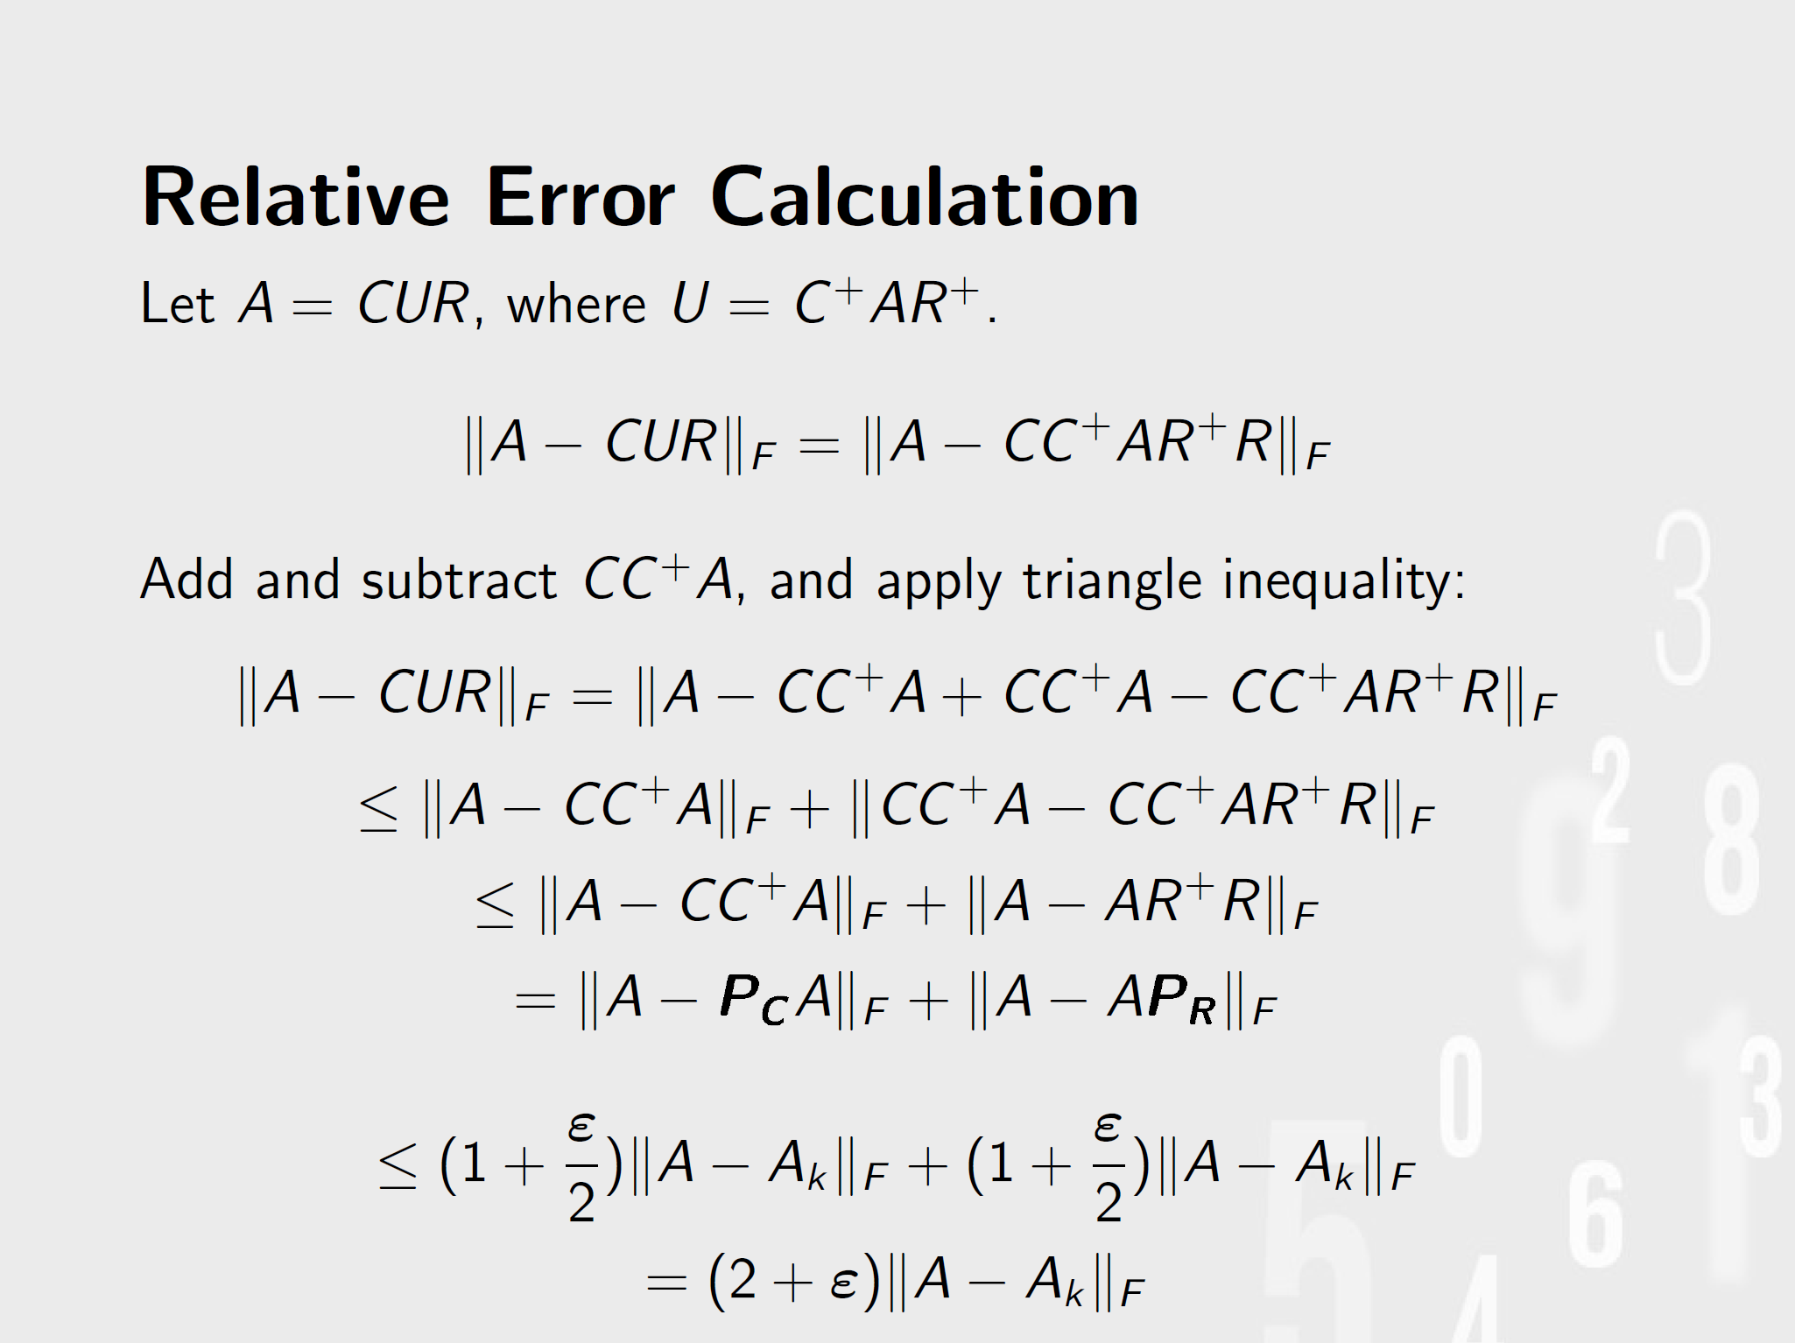

Slide 24
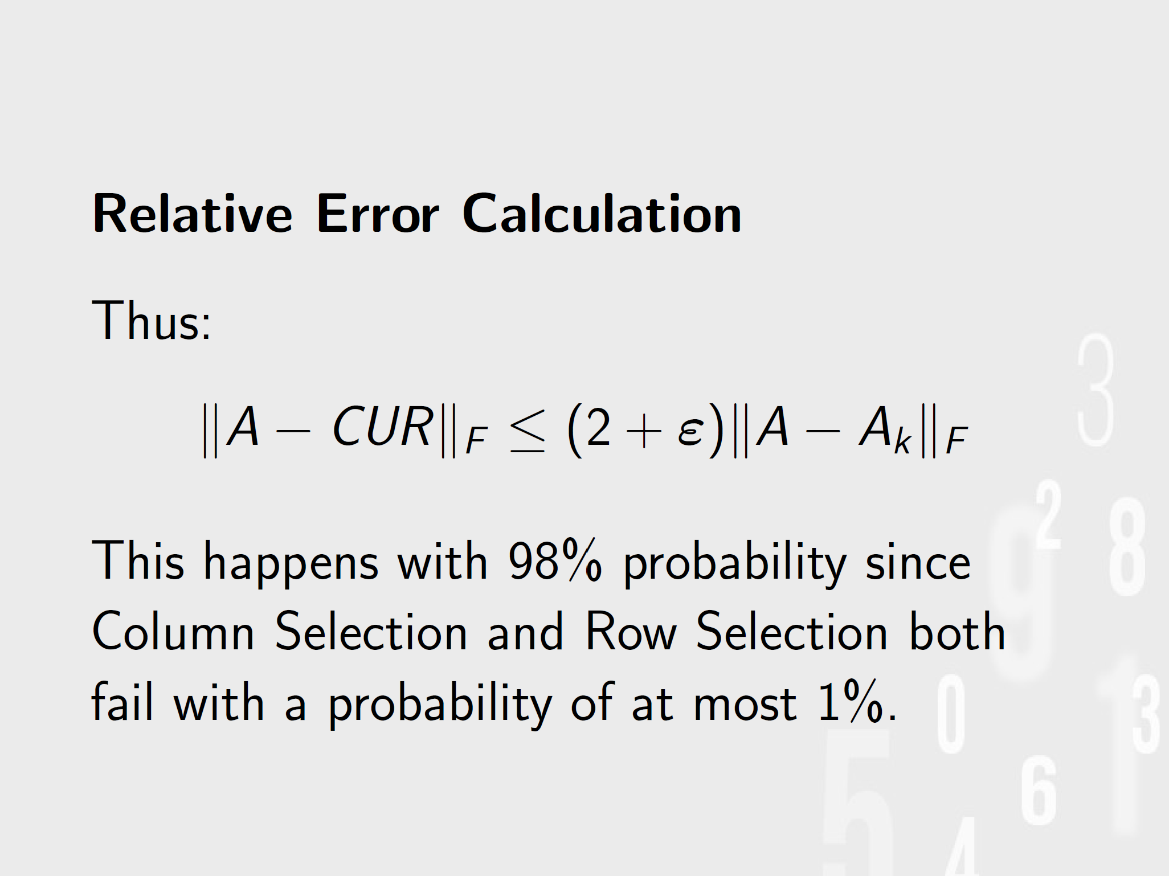

Slide 25
Algorithm
ColumnSelect :
1. Compute top k singular vectors: v1, v2, ..., vk
2. Calculate leverage scores π_{j} for each column j
3. Set constant c=O(k*logk/ϵ²)
4. For each column j:
- Compute probability p_{j}=min{1,cπ_{j}}
- Retain column j with probability p_{j}
5. Return matrix C with selected columns

Slide 26
Algorithm CUR
1. Run ColumnSelect on A with c=O(k*logk/ϵ²)
2. Run ColumnSelect on A^{T} with r=O(k*logk/ϵ²)
3. Compute U = C⁺ A R⁺
4. Define matrix U, where X⁺ denotes a Moore–Penrose generalized inverse of the matrix X
Show Sample from jupyter💡

Slide 27
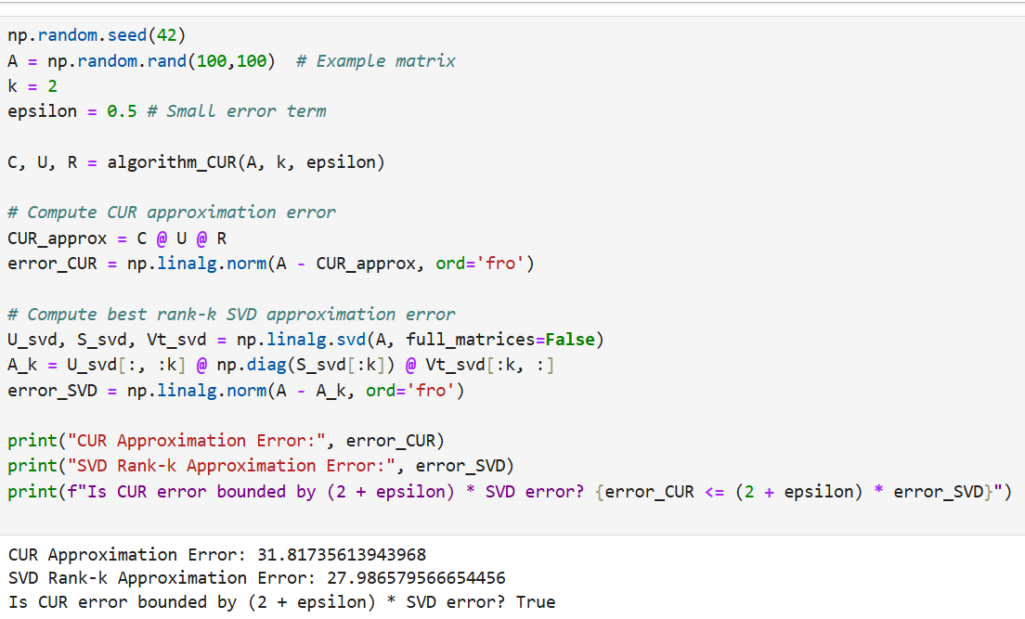
Implementation

Slide 28
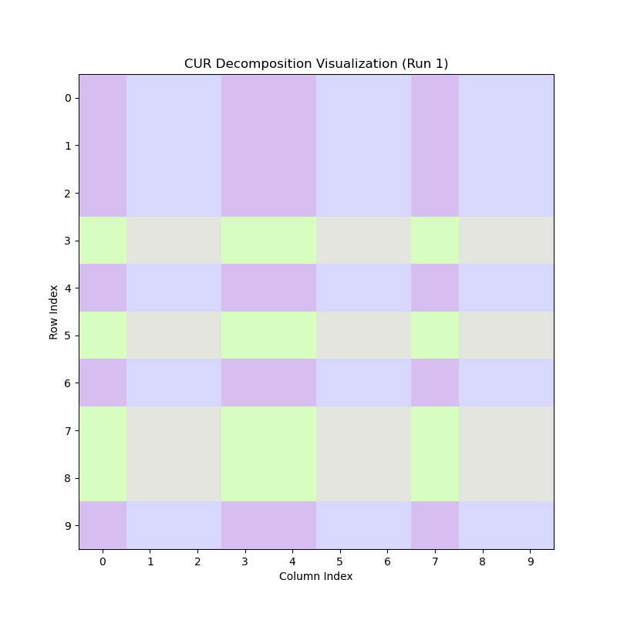
CUR Magic
This visualization is created on 33 runs of CUR algorithm on the same matrix with same k and epsilon values.
10x10 random matrix k=2
ε=0.5

Slide 29
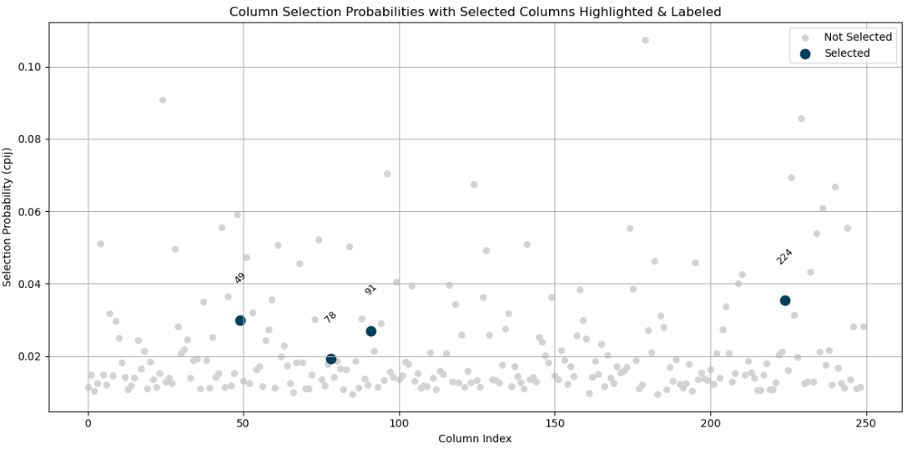
Visualizing selected columns
K=2 ε=0.5

Slide 30
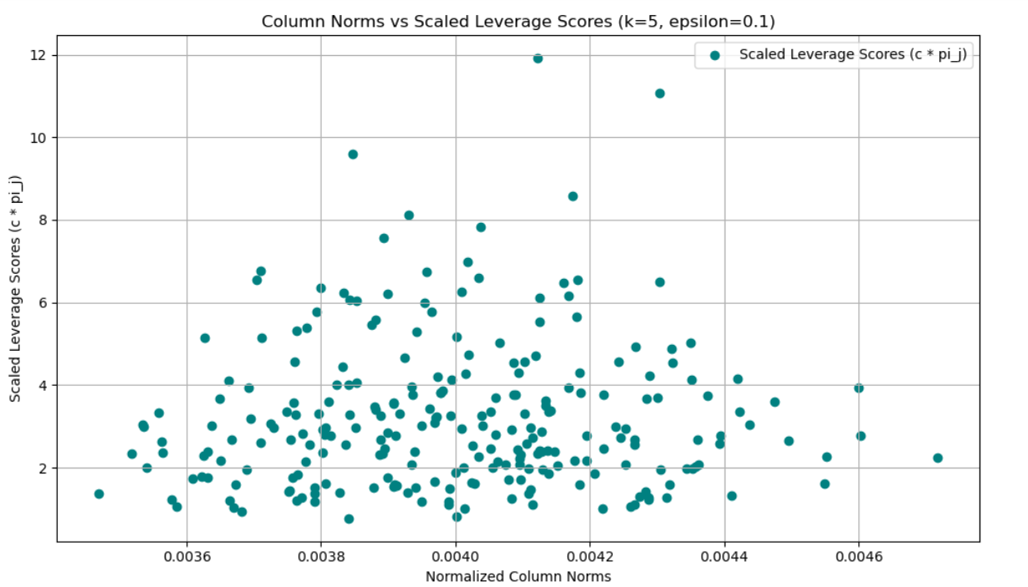
Leverage Scores with Column norms

Slide 31
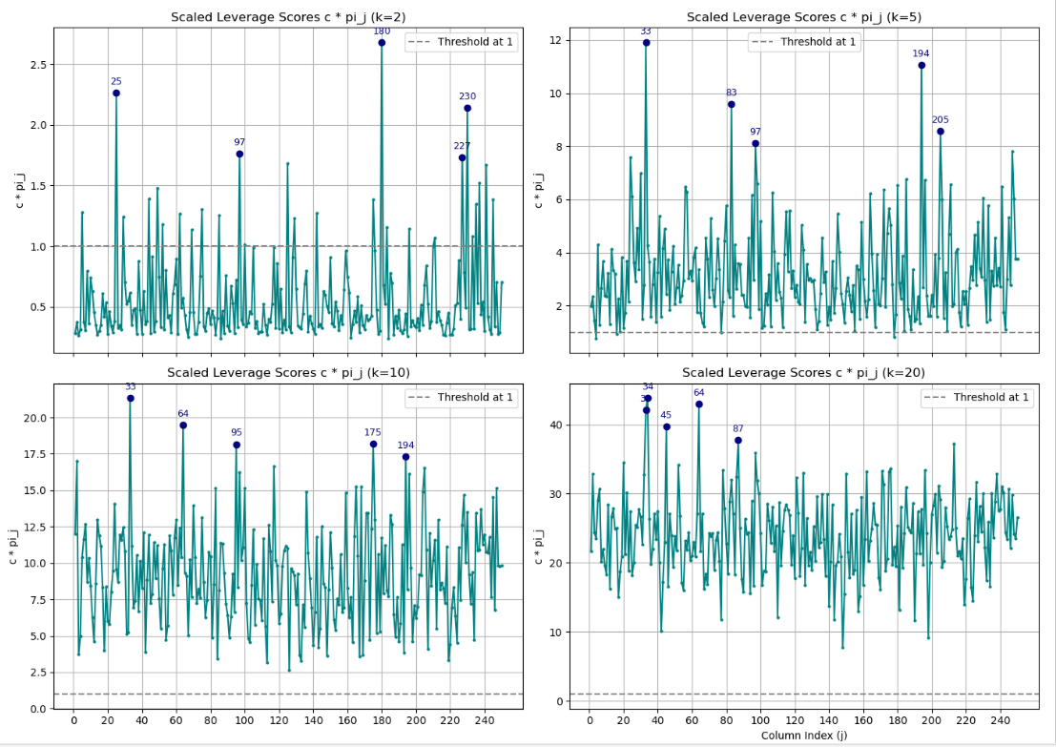
Results and Comparisons
ε=0.1

Slide 32
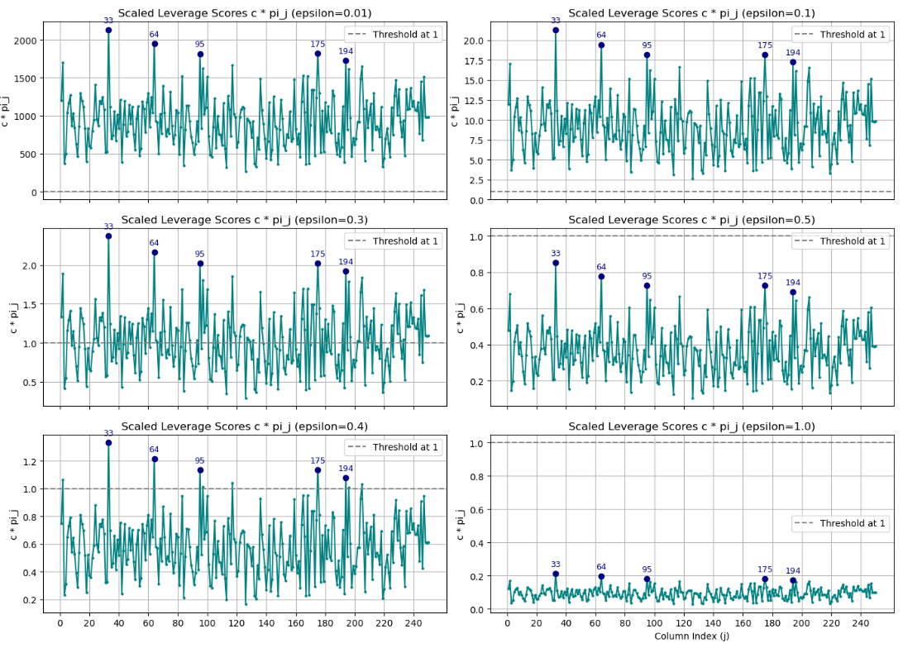
K=10

Slide 33
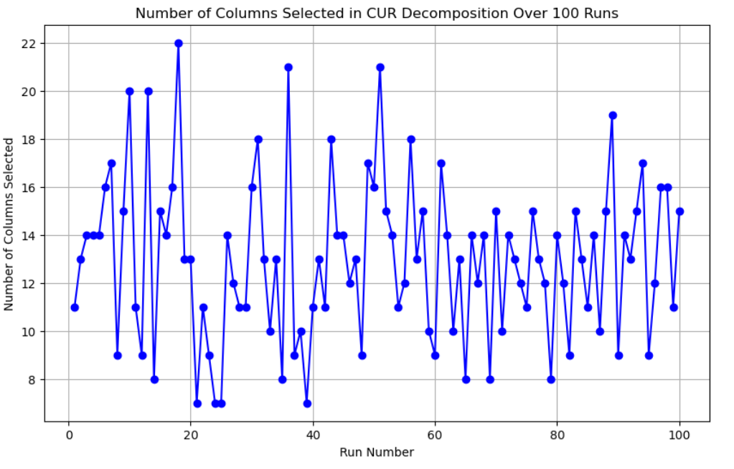
Number of columns selected over runs
A = 250x250 matrix
k = 3
ε = 0.5
c=14 (calculated using k*logk/ε²)

Slide 34
Conclusion
CUR Decomposition helps to achieve an interpretable low rank-matrix decomposition although it comes with a small tradeoff on accuracy
However, we can achieve reasonable error bound by choosing the required number of columns
By fixing an upper bound on the number of chosen columns and adopting randomized column sampling, CUR decomposition can capture the diversity in the dataset
It forms fundamental building block of data analysis methods (PCA, multidimensional scaling, factor analysis, techniques to extract nonlinear structure from data)

